Slide 1
Credit Scoring and Lead Classifier

Slide 2
Hypotheses
It is the nature of selling which the best customer must be a person who has a best purchasing power.
The KTC Data is a data collection of credit card. It include more spending behaviors
From spending behaviors, we can understand the purchasing power of customers

Slide 3

The best purchasing power
Easy to pay (จ่ายง่าย)
Can pay (จ่ายได้)
Pay all (จ่ายตลอด)
ยืมเก่ง ซื้อเก่ง
คืนเก่ง หนี้ไม่เยอะ
ถือบัตรมานานแล้วแค่ไหน
The KTC data can told to us.

Slide 4
The best purchasing power
ยืมเก่ง ซื้อเก่ง
คืนเก่ง หนี้ไม่เยอะ
ถือบัตรมานานแล้วแค่ไหน
- Cash Analysis
Balance behavior analysis
Payment analysis
- Card Age
The KTC data can told to us.

Slide 5
This leads us to build a credit scoring model

Slide 6
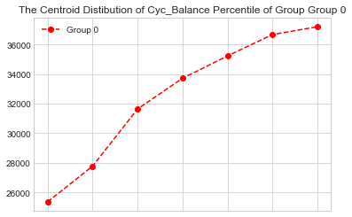
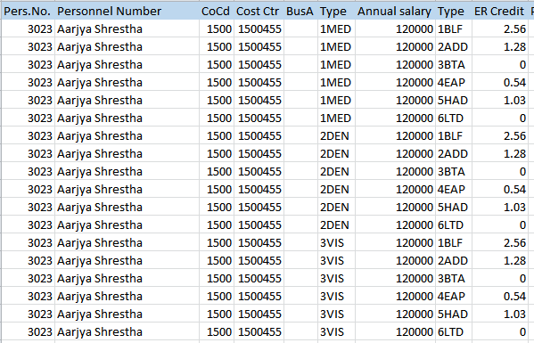
As we know behaviors can and do change. For analysis based on a cycle of transaction, it is not easy way. We will not care the sequence of the data transaction. But we will analysis the data based on variance and project to a percentile distribution from each customer’s transactions to capture his/her current behavior.
Transaction
+ Standard deviation

Slide 7
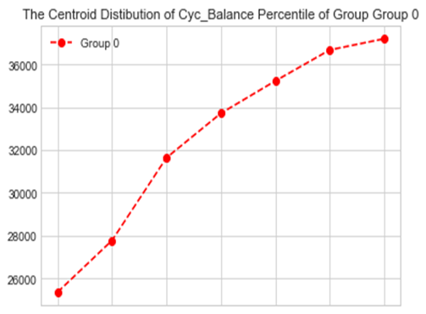

Giving Example
CyC_Balance_Max
CyC_Balance_Min
Cyc_Balance_PT_5,25,50,75,95

Slide 8
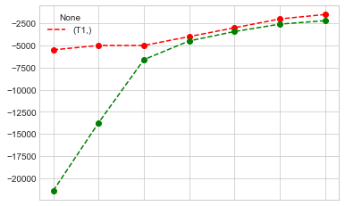
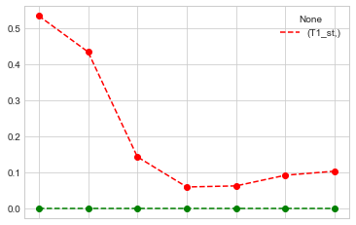
Idea: we will score by using a percentile distribution of one customer compare with the average of all percentile distribution of customer. The difference distant will be a score of customer
Z score transform
** A Z score (or standard score) is a standardization technique which calculated by taking the raw score and transforming it to a common scale.

Slide 9
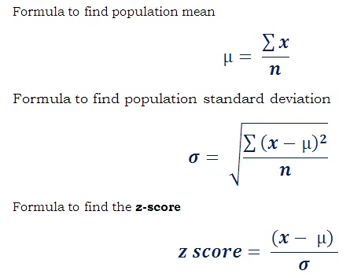
Idea: we will score by using a sampling of percentile distribution of one customer compare with the average of all sampling of percentile distribution of customer. The difference distant will be a score of customer
** A Z score (or standard score) is a standardization technique which calculated by taking the raw score and transforming it to a common scale.

Slide 10
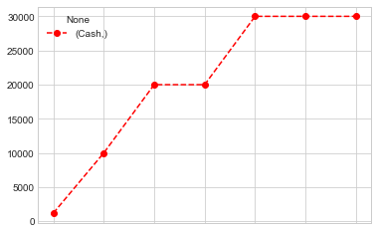
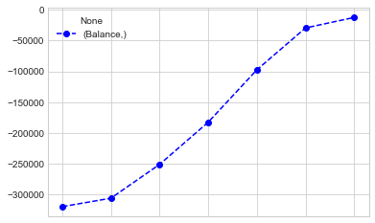
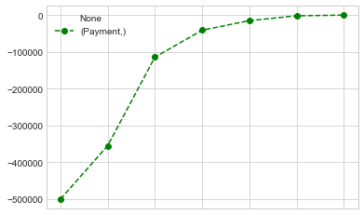
We looking in three points view
Cash (กดเงินสดมากน้อยขนาดไหน)
Balance (ยอดหนี้สะสมมากน้อยขนาดไหน)
Payment(จ่ายคืนกลับมากน้อยขนาดไหน)
Example :: 'CARD_NO' = 4216680002739549

Slide 11
Given example

Slide 12
To do with the descriptive data (Optional)
DOB
Gender
MONTHLY_INCOME_RL
Marital_status
Mobilephone_fg
Officephone_fg
Homephone_fg
NO_OF_CHILD
Occupation
Province
Total_Credit_Limit
Customer_Status
Is_Staff
Is_KTC_Credit_Card_Holder
Age
Account_Status
Current_Balance
Card_Age
CARD_NO

Slide 13
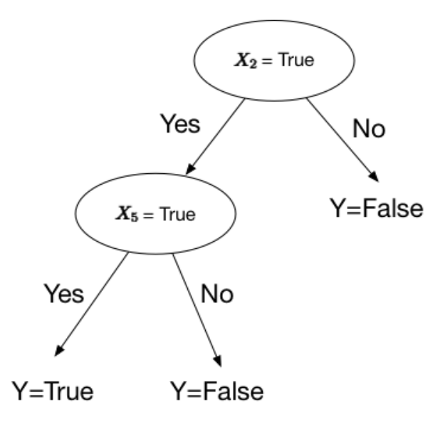
We will use the knowledge from lead of PT23 (i.e. respond, descriptive fields ) to create a classification (machine learning model) which decide customer who will buy the product PT23. (This process has been collected the data from first lead or hot lead)
A Lead will generate from two model (the credit score model and classifier).

